Slide 2
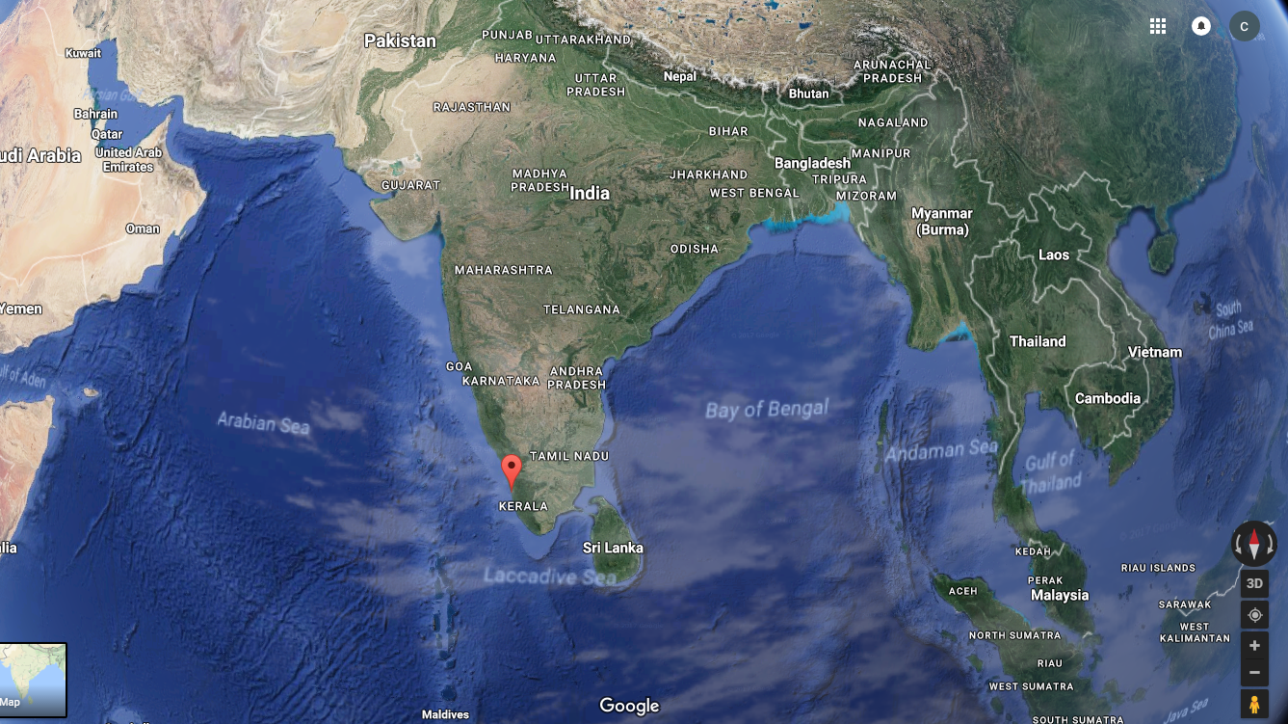
KOCHI – The locational map
Kochi City

Slide 3
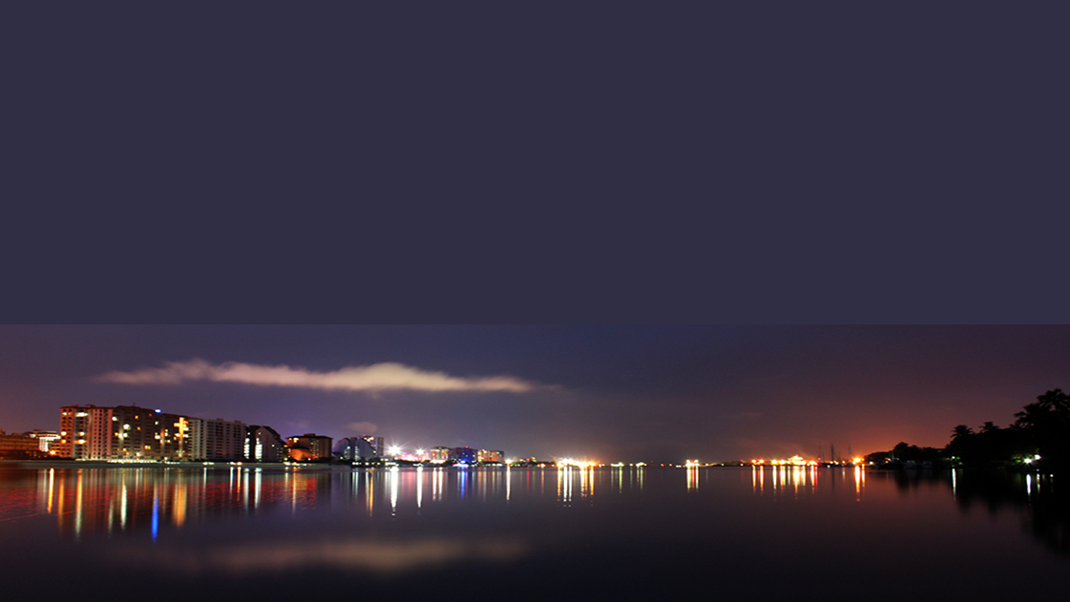
CITY PROFILE
Topography - 1.5 m above MSL ;
Urban Agglomeration -Population :– 12,52,000;
Area: 330 sq.km;
Central city - Population – 6,55,697, Area:- 94.88 sq.km ,
Located between 76⁰ 14’ and 76⁰ 21’ East longitude and 9⁰ 52’ and 10⁰ 1’ North Latitude.

Slide 4
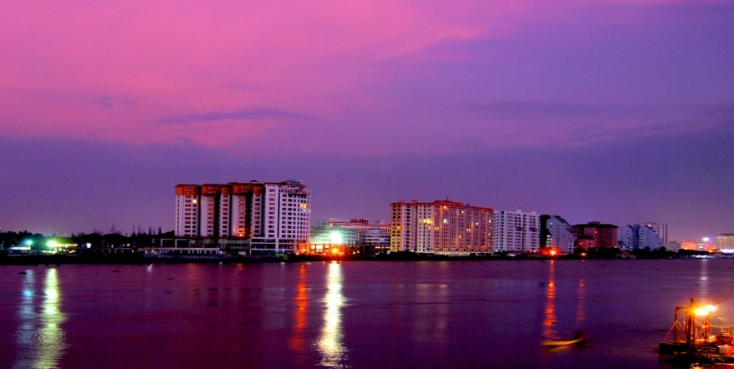
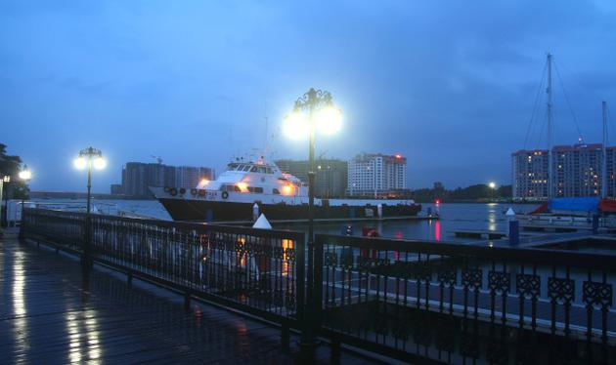
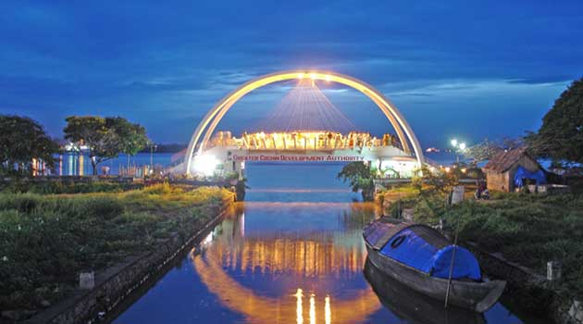
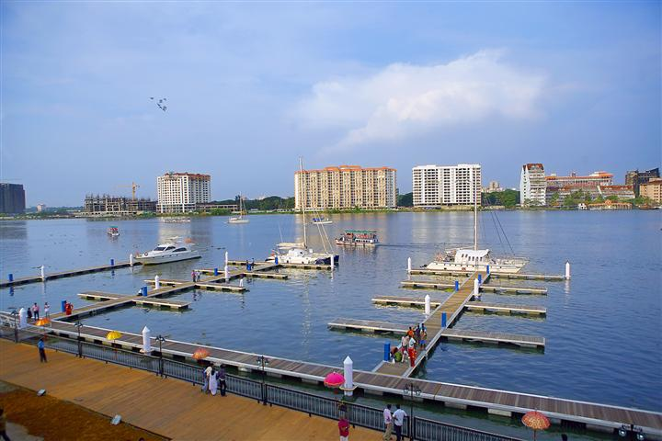
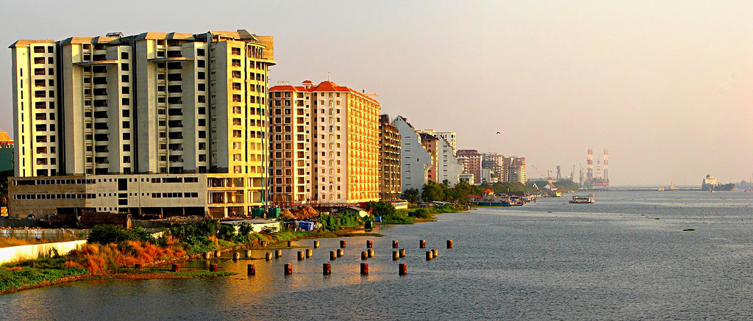
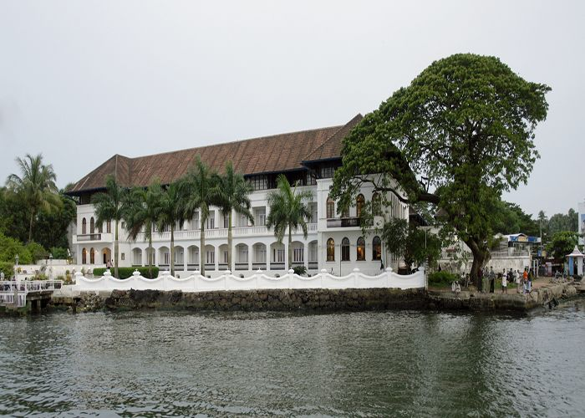
KOCHI
Commercial Capital of the State of Kerala , in South India
Has a strong deep water economy
2nd most important port city on the western coast of India
Emerging hub port to become gateway to South East Asia.
“Water Based City” retaining the environmental characteristics of the network of canals and backwaters.
Has 48km of waterfront with development potential for commerce and tourism .
Convergence of all modes of transport.
High quality educational and medical facilities.
City which is an IT Hub with optical fiber connectivity
Heritage City with development aspirations and pressures
A tourist destination.
VISION - ‘An economically productive, effective and egalitarian metropolis which will provide to all sections of society the desired level of services and attract worldwide attention as a preferred destination for Health care, Heritage, Tourism, IT and Port based services’.

Slide 5
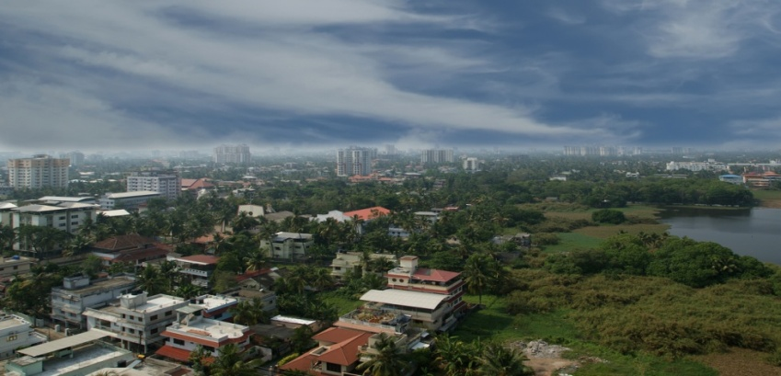
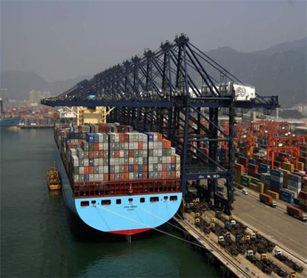
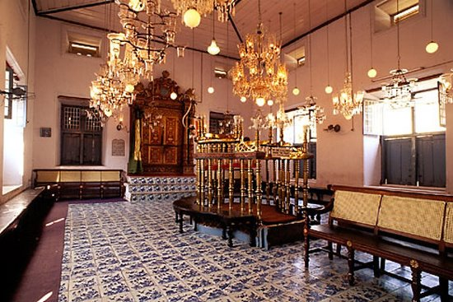
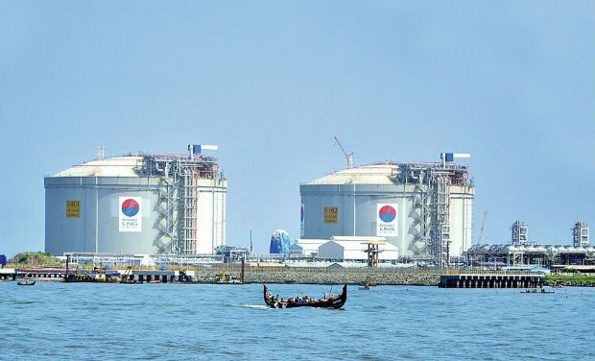
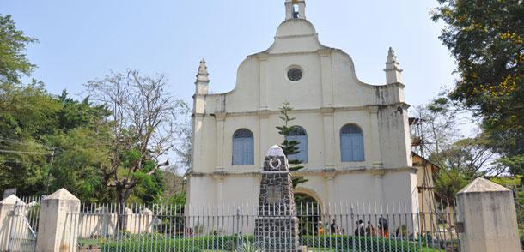
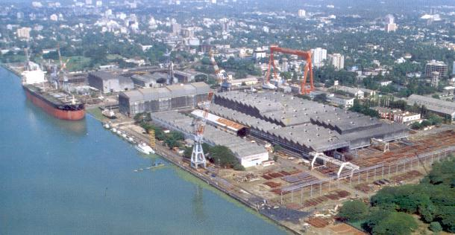
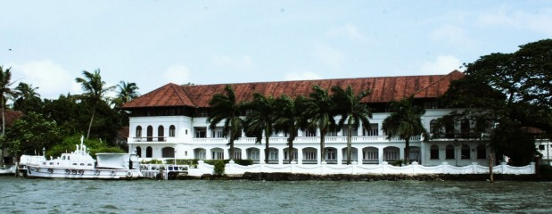
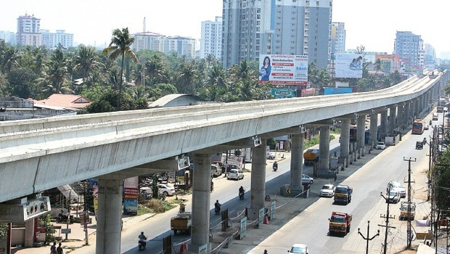
GROWTH TRIGGERS
International Container Transhipment Terminal
LNG Terminal
Bunkering Terminal
Ship repair facilities
IT & ITES centres, IT Smart City
Special economic zones
Backwater and Heritage Tourism potential
Metro Rail
Water Metro Project
Smart Cities Project
MISSION – To serve the citizens through quality service, innovation and leadership for today and future.

Slide 6
Urban challenges
Climate Change
Sea-Level rise
Blocked canals and waterways leading to floods
Growth in number of vehicles @ 70 % per decade compared to the population growth @ 9 % per decade
Congested roads
Poorly managed public transport
Water pollution
Waste Management
Lack of proper sewerage system
Depleting conventional energy sources.
Key Issues
of
Kochi
Transportation
Energy
Solid Waste Management

Slide 7
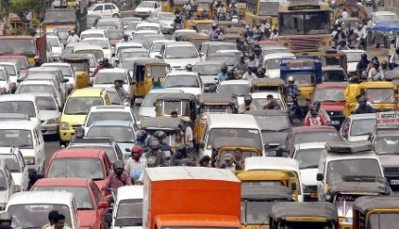
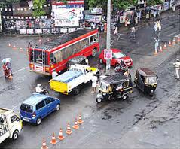
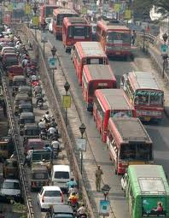
TRANSPORT
Main Problems in the transportation sector
Poor road geometric
Uncontrolled Ribbon development along road side.
Bottlenecks created by narrow bridges, Rail crossings, Poor road drainage.
Lack of sufficient links between the radial and ring road.
Lack of proper road linking the ring roads on the regional periphery which can bye pass the urban region.

Slide 8
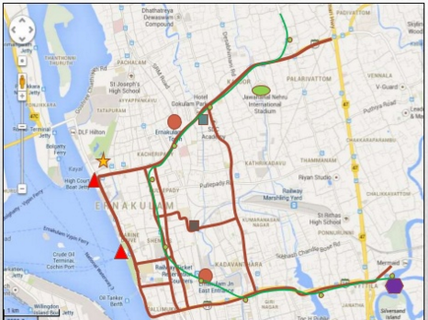
MITIGATION MEASURES - TRANSPORTATION
Traffic circulation plan for CBD area
Identification of scope for improving congested junctions
Parking proposals and pedestrian plans
Rerouting plan for public transport system
Proposals for relocation of bus and truck terminals
Proposals for bypasses, links and missing links
Formulation of transportation development schemes
Interchange points between MRTS/ future rail networks
Phasing of the schemes along with project costing
Formation of a Metro Politan Transport Authority (MTA)

Slide 9
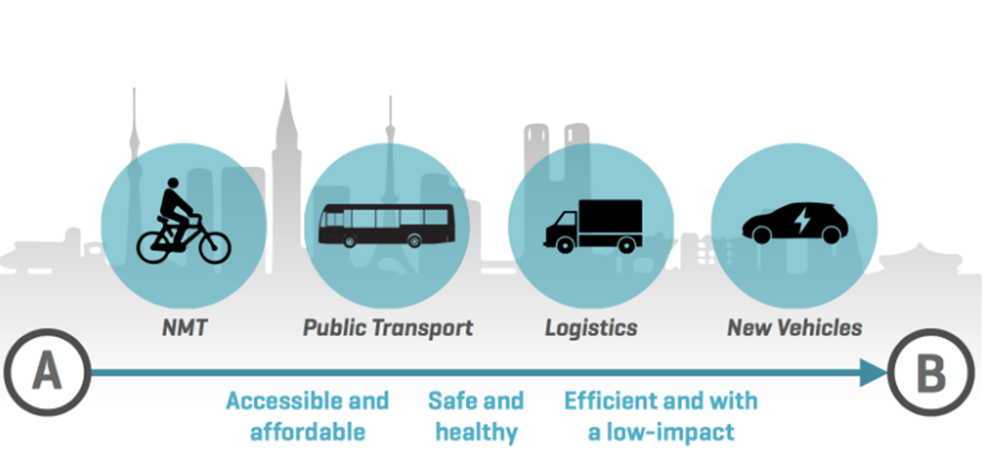
Urban mobility & sustainability

Slide 10
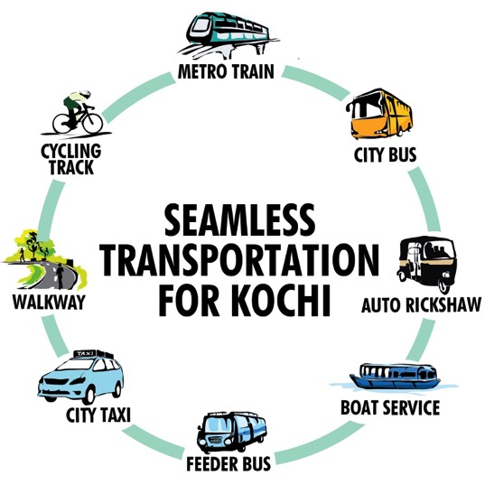
Let’s Integrate !
One Network, One Timetable, One fare

Slide 11
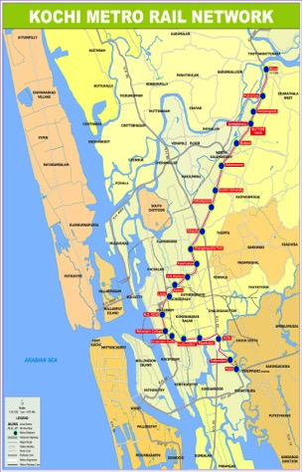
Kochi metro rail
Fastest constructed metro rail
Total 26 km proposed
16 km functional
Kochi1 Card to be used across all modes of transport

Slide 12
City Bus Integration
1400 Buses – 1000 private and 400 State run
69 buses per lakh population within the Greater Kochi Region
Notorious for over speeding
Safety at risk
Lack of terminal and depot space
Modal share of city bus transport is expected to increase from 45.2% in 2015 to 50.1% in 2017 and 52.3% in 2026
Integration of private buses into a society
The move is expected to improve organizational output as well as passenger reliability and comfort

Slide 13
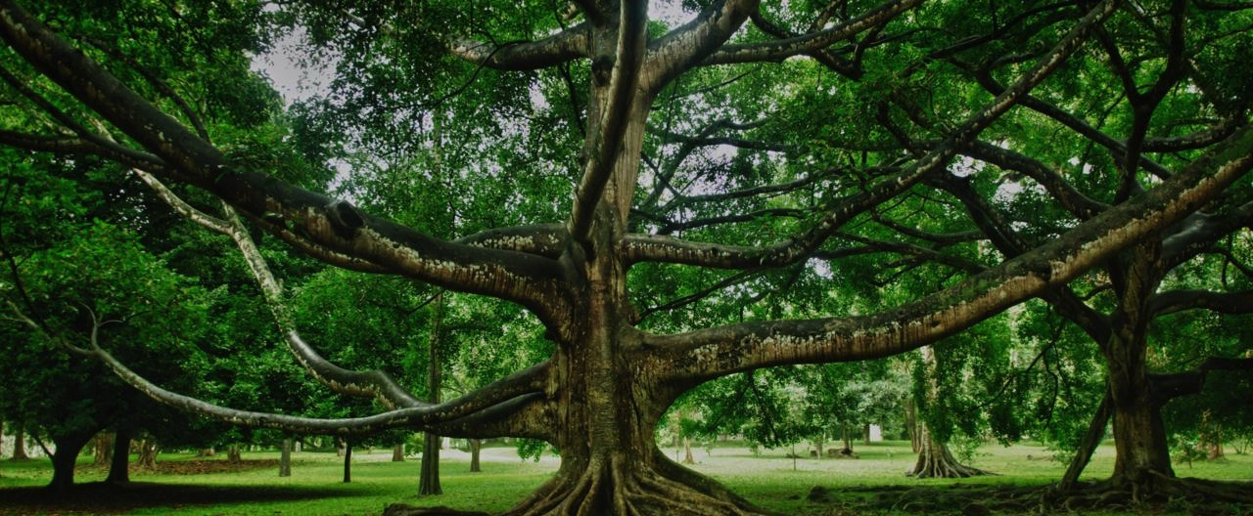
Sustainable Eco System for Transport
KOCHI

Slide 14
Non motorised transport- WalkwayS & CyclEs

Slide 15
ENERGY
The state of Kerala depends on hydel resources as the sole means to produce power for itself.
When the monsoon fails, water storage becomes scarce and power shortage drives the State to load-shedding and similar hardships.
There is a need to explore alternative source of energy.
Energy Austerity !!!

Slide 16
Kochi -energy profile

Slide 17
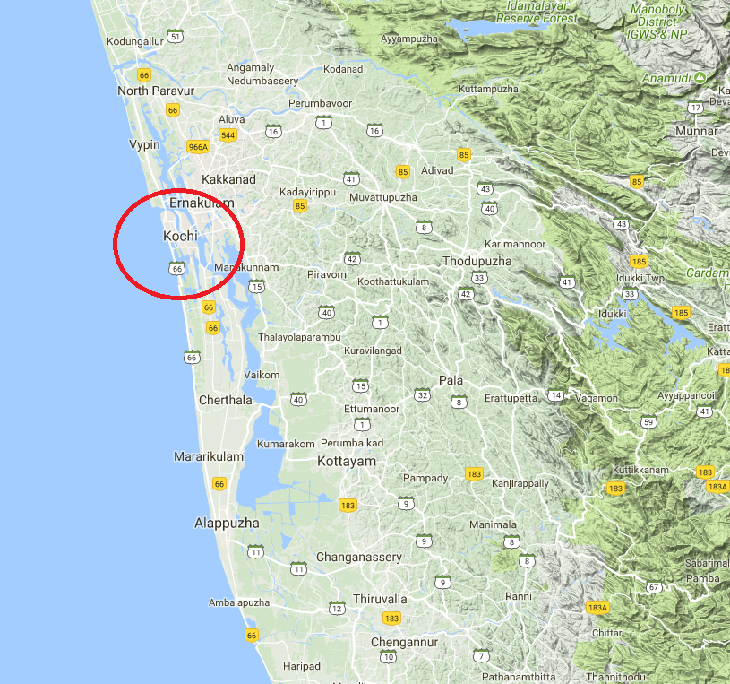
Exploring Alternative source of energy
Kochi lies
between 9.48° N and 10.50° N latitudes
&
between 76.5° E and 76.58° E longitudes
- Receives good amount of solar radiation
( an annual average of 5.30kWh/ m2/day )

Slide 18
100% KOCHI
Transition to 100%renewable energy for all purpose
(electricity, transportation, home, industry)
Kochi Solar City Project
Solar Smart
Solar Connect
Solar Home Lighting System

Slide 19
Solid waste management
Solid waste management a major issue for city!!
Present solid waste treatment plant at Brahmapuram ( located 16.6 km from the centre of the city), with a capacity of 250 Ton per day.
Not functioning to its full capacity :
Machines have developed technical snag
Cracks have developed in the floor of almost all buildings in the plant.
Signs of settlement of foundation.
‘Not in my backyard’attitude of the people.
Need for an alternative
WASTE TO ENERGY PLANT

Slide 20
Waste to Energy plant
New plant will have capacity to process 800 tones of waste daily.
Waste is heated at 900-1,000 degree Celsius to produce energy (pollution free) [GASIFICATION]
As many as 8 MW energy can be generated by the plant.
Technology uses minimal energy with effective drying through eco-friendly patented natural process.
Power generated from the MSW will be purchased by Kerala State Electricity Board (KSEB)
The project fully supported by the Kochi Municipal Corporation, State Government and the Government of India.

Slide 21
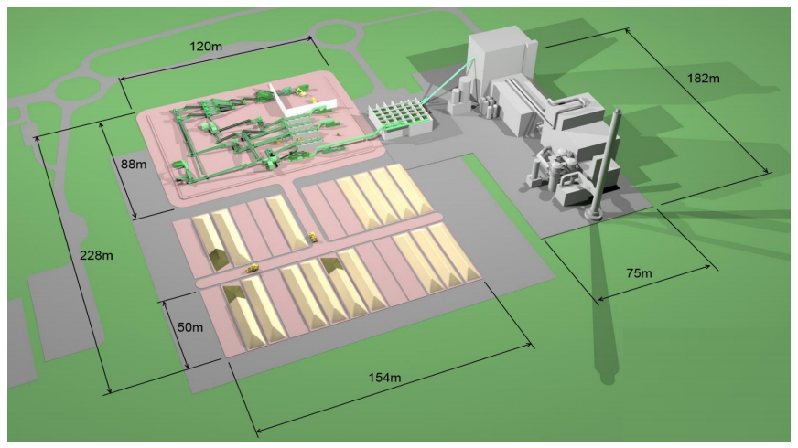
Proposed Waste to Energy plant

Slide 22
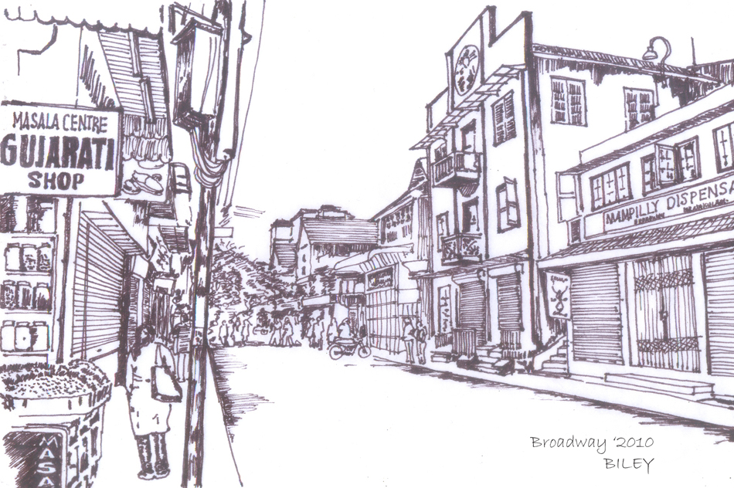
RAPID URBANIZATION
ADAPT
THRIVE
EMBED
DEVELOPMENT
SUSTAINABLE DEVELOPMENT

Slide 23
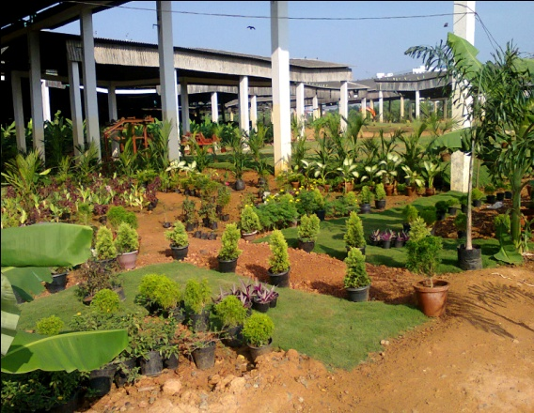
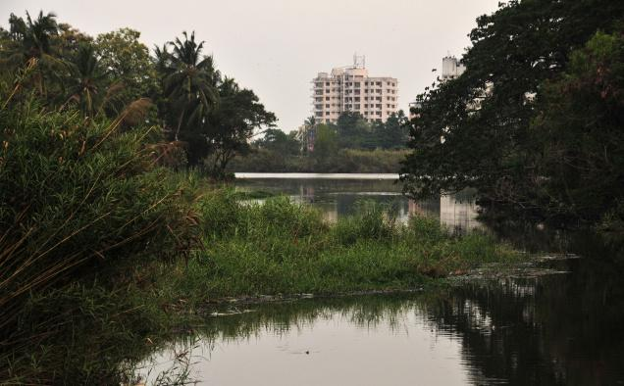
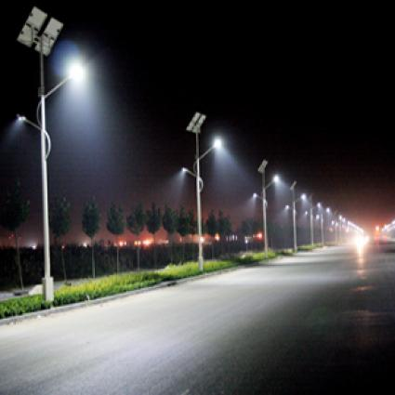
Related Initiatives Taken By Kochi
Comprehensive Master Plan
City Sanitation Plan
Water Policy
Restoring city’s canal and drainage system
Strict guidelines and building rules
Coastal zone regulation act
Effective waste disposal infrastructure
Awareness Creation
Promoting investment in renewable energy technologies

Slide 24
In Kochi, we are incorporating Sustainability in our……..
Vision
Strategies
Implementation
Policies
Goals

Slide 25
Our mission
To have effective strategy and projects for climate change impact mitigation
To have transportation facility of International standards
To have waste to energy plant.
For the completion of urban infrastructure improvement programmes in a time bound manner
To make Kochi a place assuring benefits of development to all sections of society
To make the city an ideal place of good quality of life for the people

Slide 26
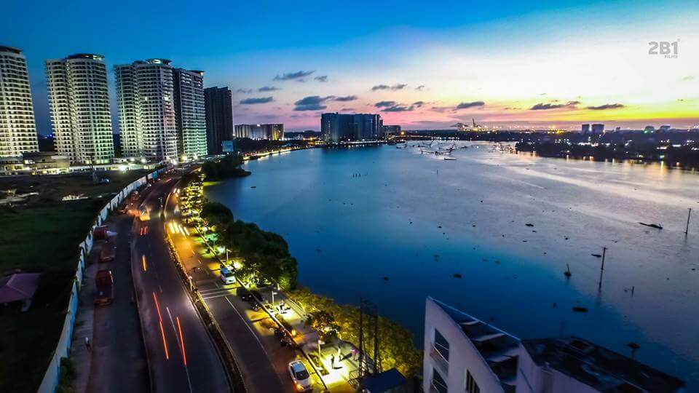
Thank you
Dr. Rajan Chedambath
Director
Centre for Heritage, Environment and Development

